Slide 1
Developing a better U33
Sergei Pourmal
Craik Lab
Winter Quarter Rotation Talk
April 14th, 2016

Slide 2
Peptide
Target
Ladder
Lysate
Peptide
biotin
biotin
biotin
HEK293 Cell Lysate
hv
Photocross linking
Visualize
Streptavidin 800
Anti-CHIP 1°
Goat Anti-Rabbit 680 2°

Slide 3
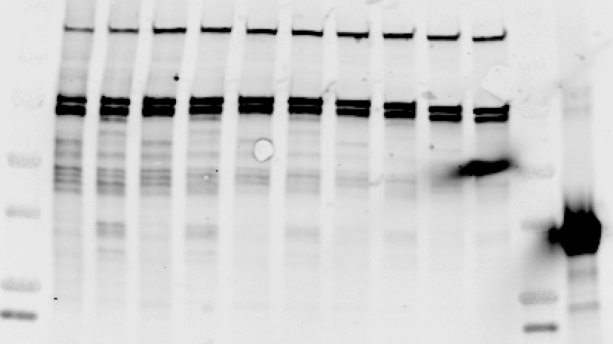
Probe titration
10 uM
5 uM
1 uM
500 nM
100 nM
Recombinant CHIP
IDMVD
ladder
IDMVD
IDMVA
IDMVD
IDMVA
IDMVD
IDMVA
IDMVD
IDMVA
IDMVD
IDMVA
ladder
37 kD
Streptavidin 800

Slide 4
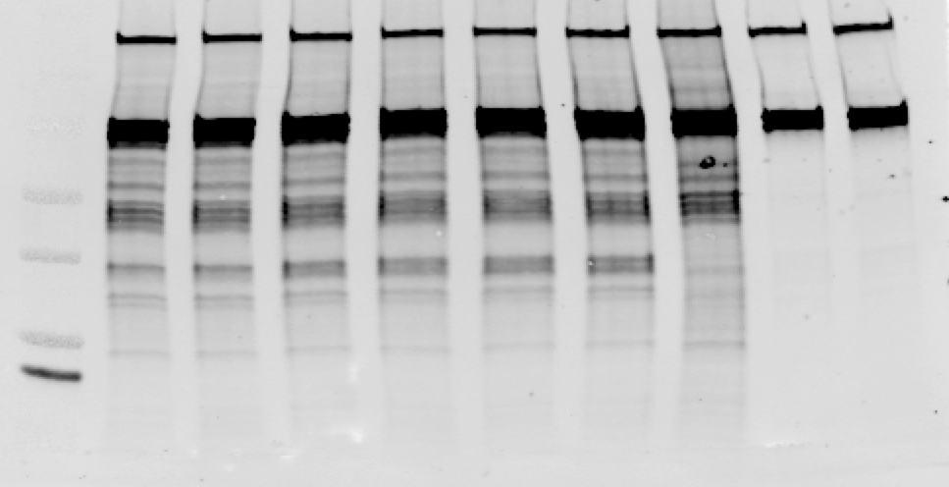
IDMVD peptide titration
1E42
probe
IDMVD
Peptide
alone
DMSO
ladder
10 uM
5 uM
1 uM
500 nM
100 nM
-
10 uM
37 kD
Streptavidin 800

Slide 5
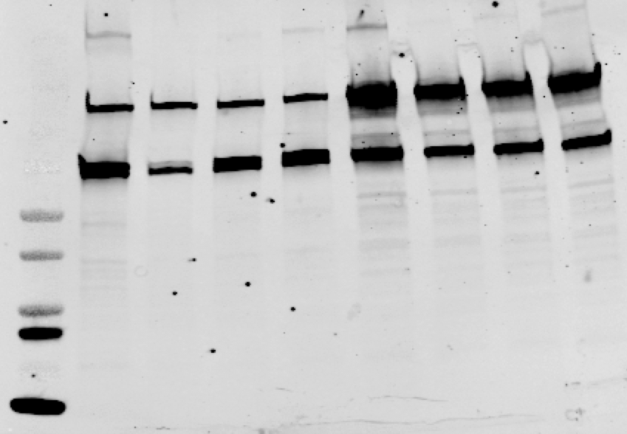
HEK293
N2a
30 ul
30 ul
-
5 uL
10 ul
-
5 uL
10 ul
37 kD
Streptavidin 800

Slide 6
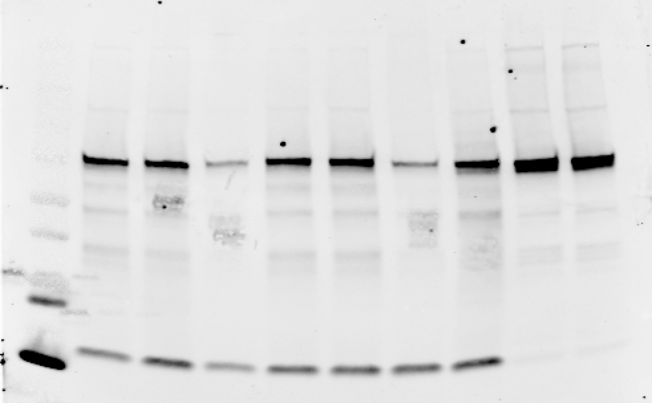

Slide 7
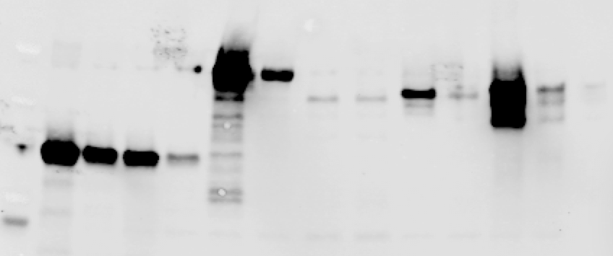
CHIP
CHIP K31A
HOP
FKBP51
FKBP52
DNAJC7
IDMVD
IDMVA
IDMVD
IDMVA
IDMVD
IDMVA
IDMVD
IDMVA
IDMVD
IDMVA
IDMVD
IDMVA
ladder
37 kD
Streptavidin 800

Slide 8
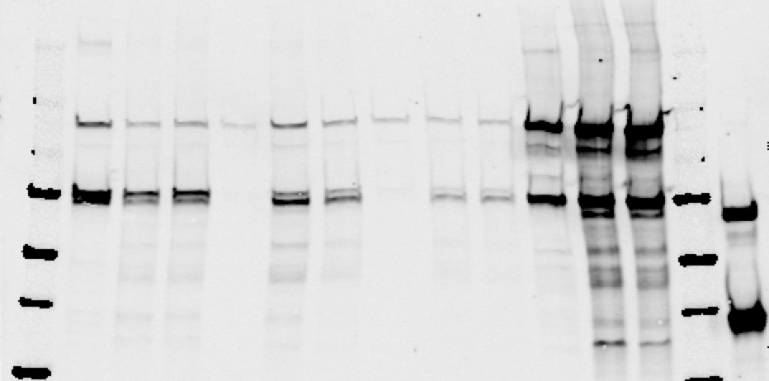

Slide 9
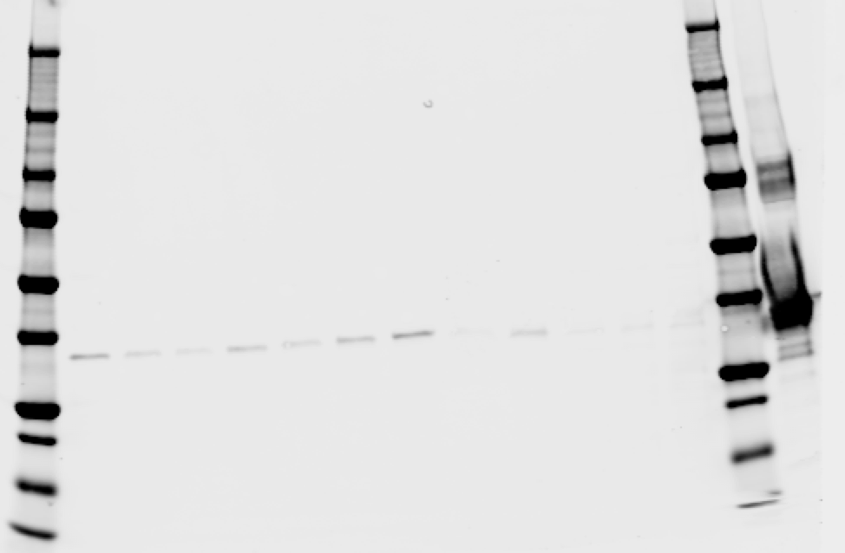
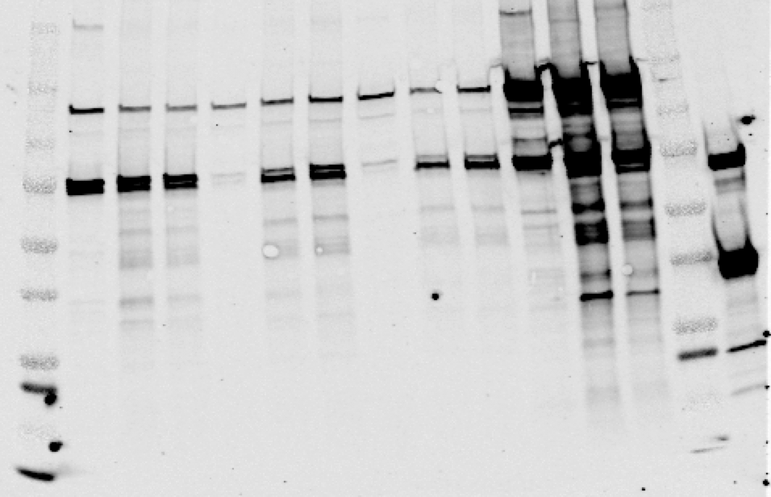

Slide 10
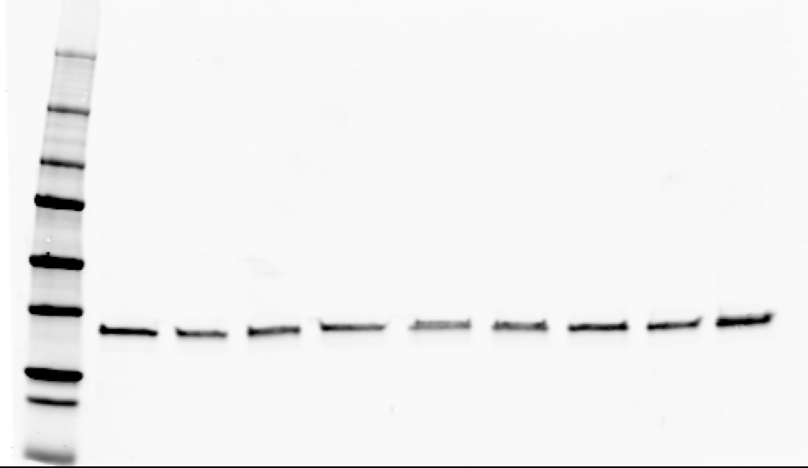

Slide 11
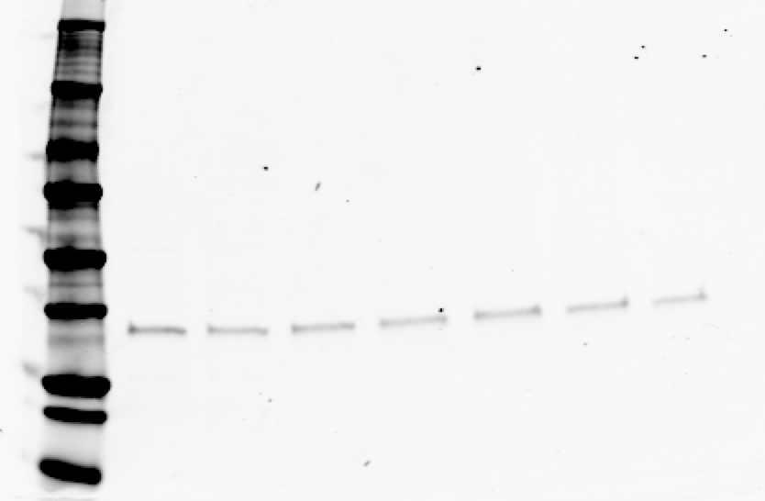
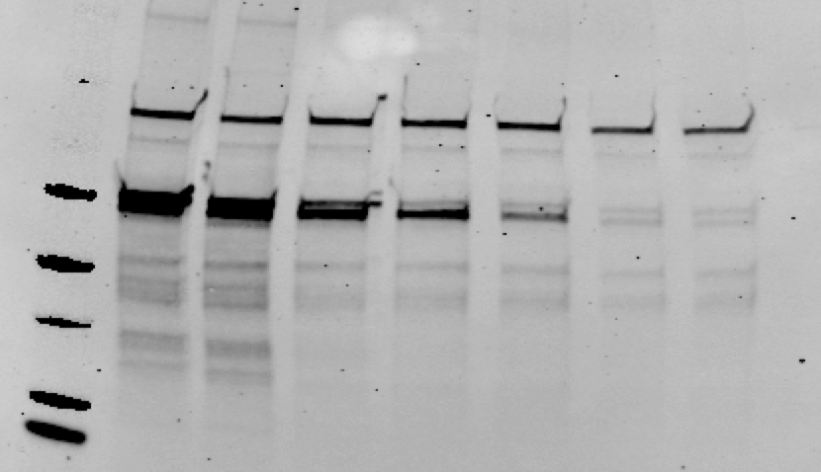

Slide 12
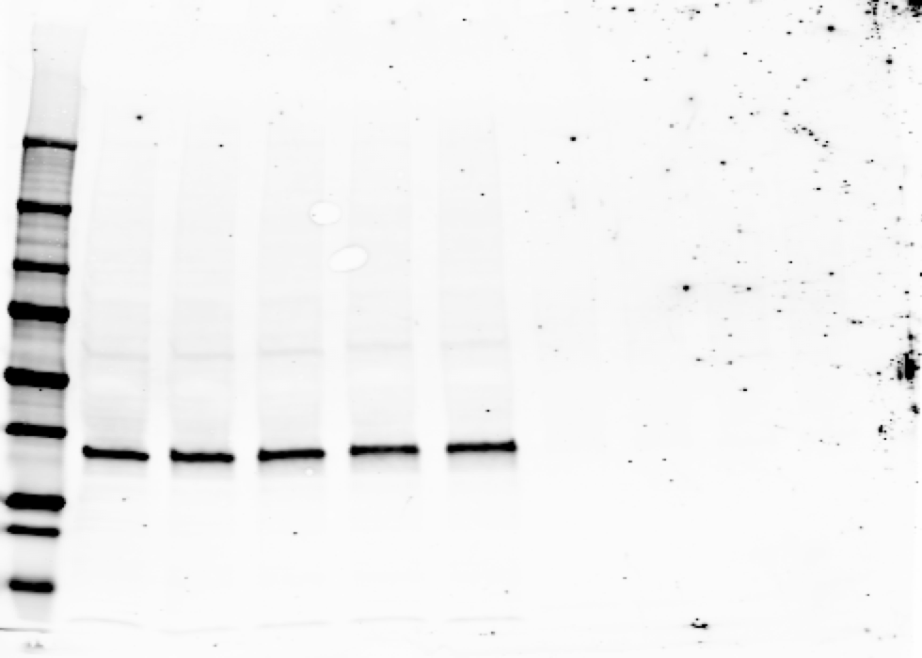

Slide 13
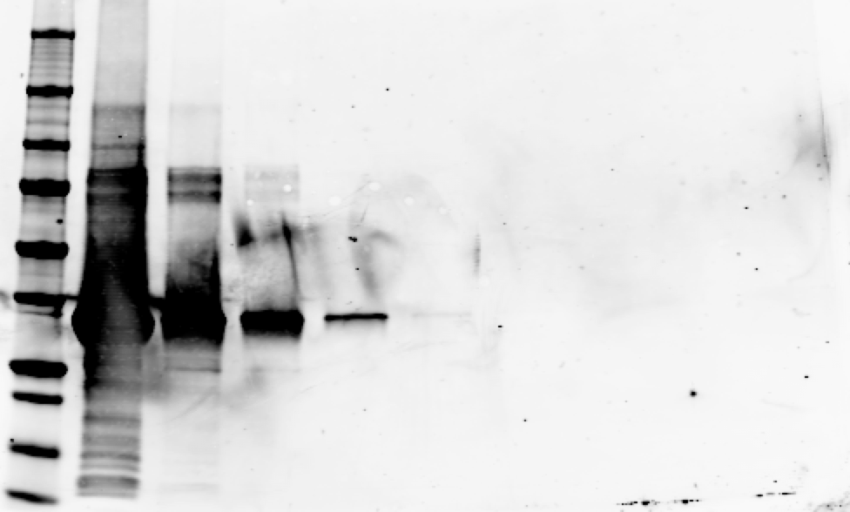
ladder
10 ug
1 ug
100 ng
10 ng
1 ng
100 pg
10 pg
CHIP (680)

Slide 14
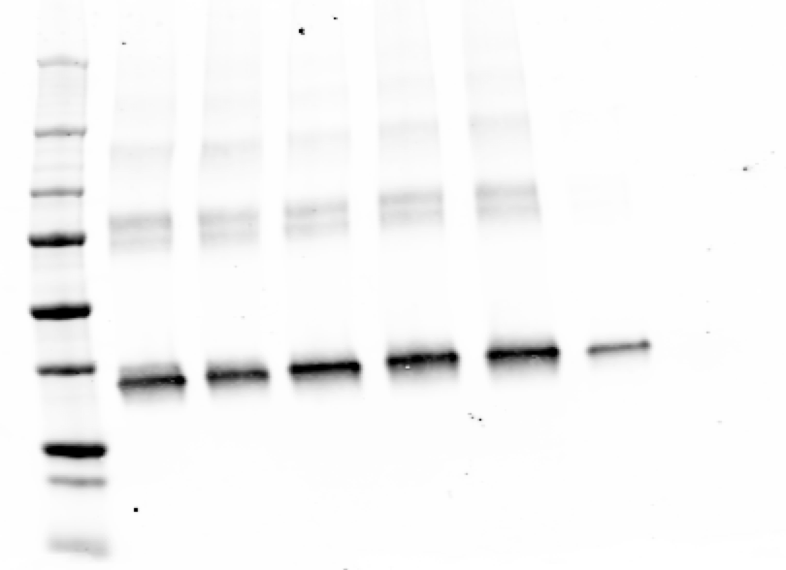
CHIP (680)

Slide 15
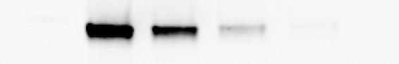
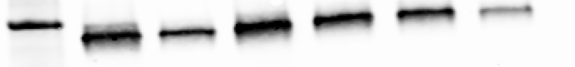
1 uM photocrosslinked probe
10 ul beads
30 ul beads
60 ul beads
-
ladder
Streptavidin 800
37 kD
No probe
1 uM photocrosslinked probe
30 ul beads
10 ul beads
30 ul beads
60 ul beads
-
-
ladder
CHIP (680)
37 kD

